Slide 1


ROBOFEST 4.0
TWO WHEEL SELF BALANCING ROBOT IIT BHUBANESWAR

Slide 2

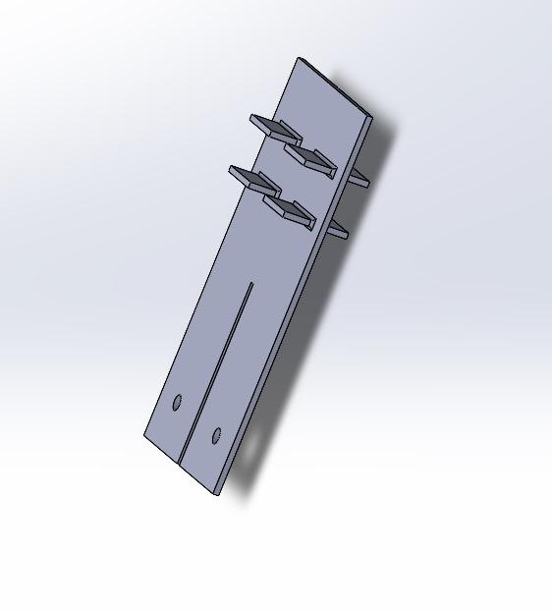
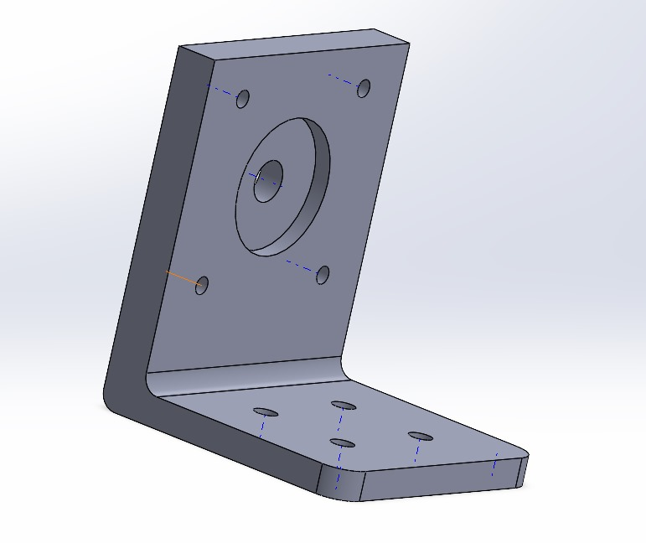
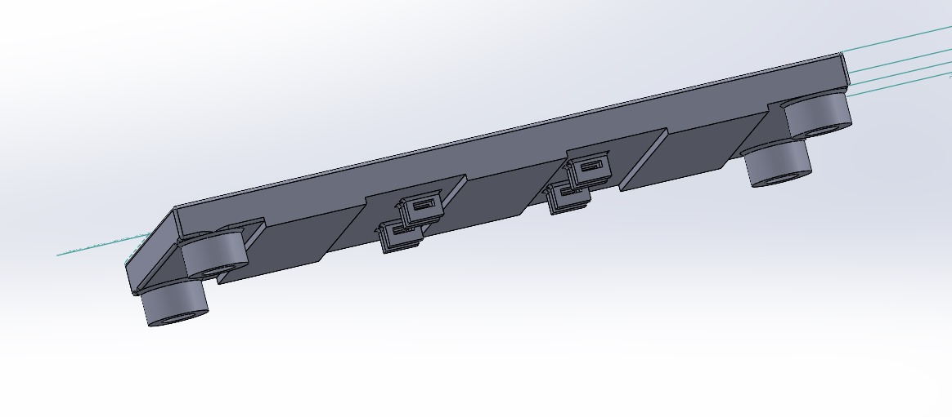
Robot Design
Structural Framework: Designed frame using:
8 rods
3 Plates
2 side motor supports
Battery and Container Design: For stability:
Dedicated battery slot
Baffles with holes
Cantilever protrusions in baffles
Strength and Durability: Thin ripples in the upper plate:
Reduces thickness
Increases strength

Slide 3
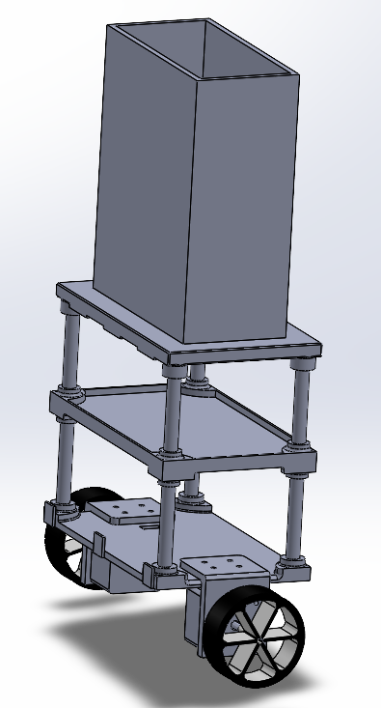
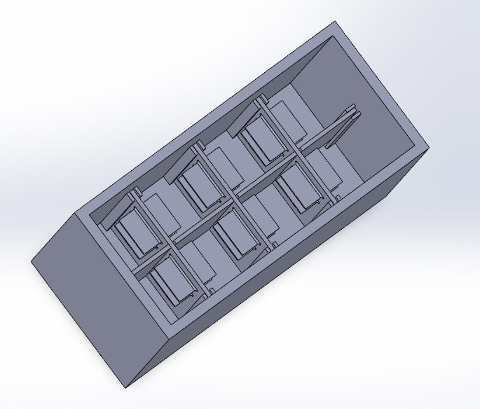
Fig.2: Beaker
Fig.1:Isometric view of model.

Slide 4

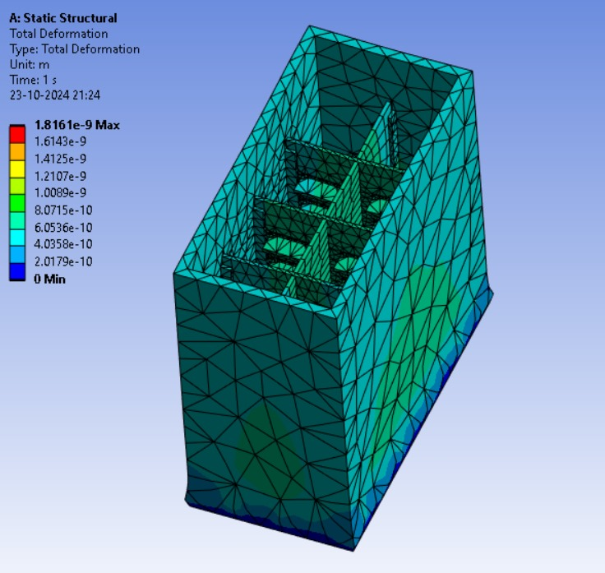
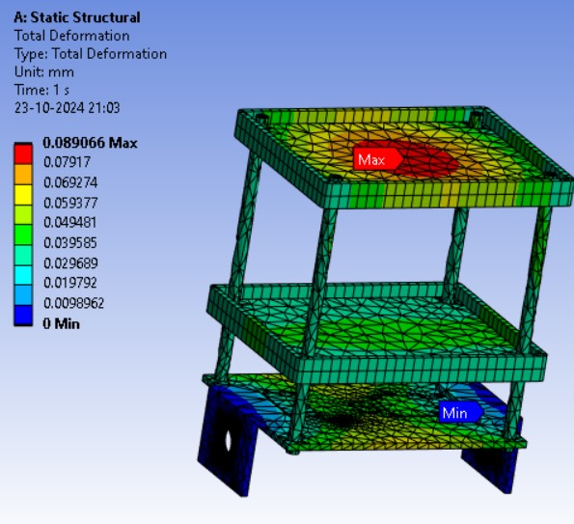
Total deformation analysis of the main structure and beaker

Slide 5
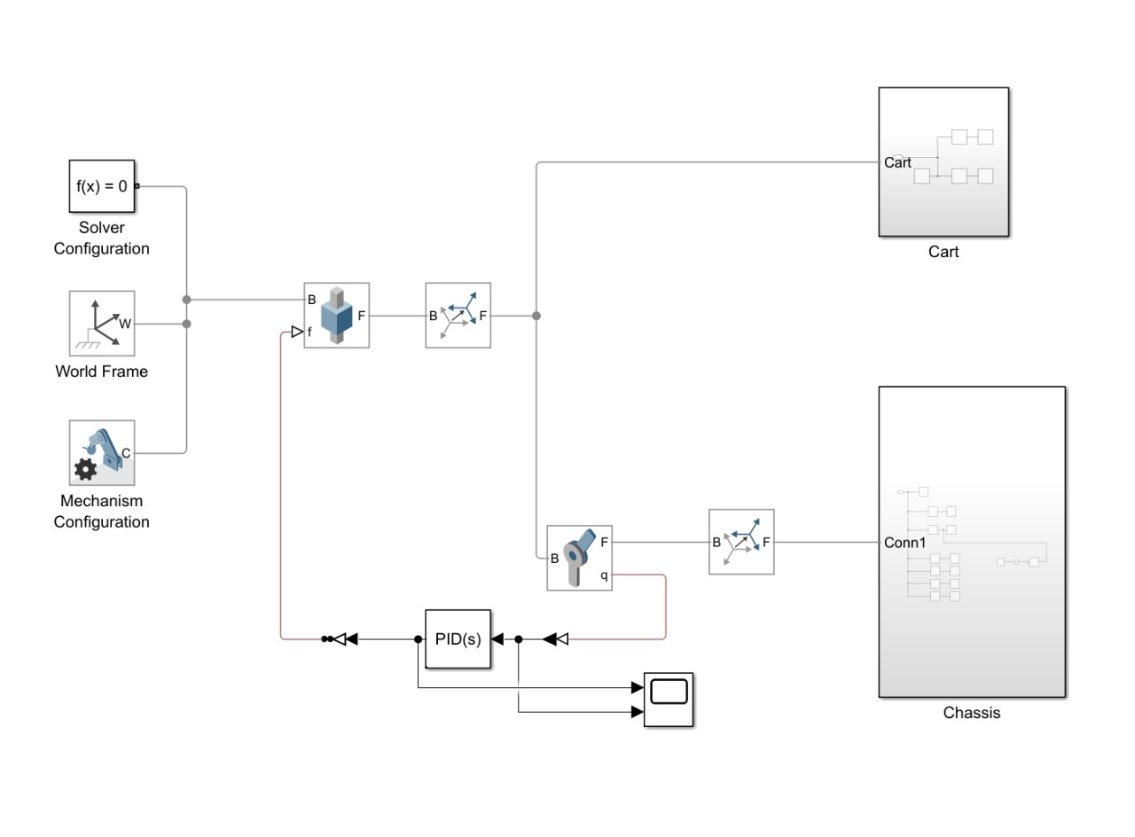
Simulation

Slide 6
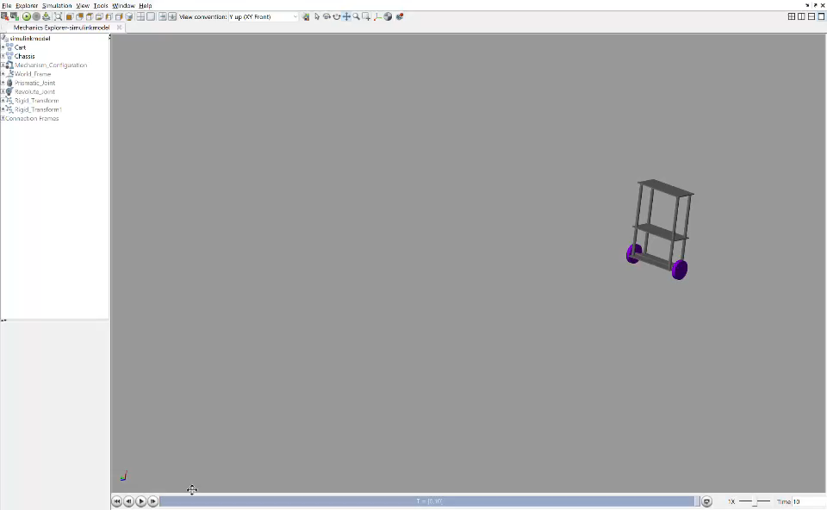
The video below shows the simulation:

Slide 7
Circuit
Simple and Reproducible Circuit
Arduino Nano (micro-controller):Arduino Nano is used as the microcontroller to run a PID control algorithm.
Motor drivers to power the motors.
Sensor Integration via Infrared Sensors (IRs)
MPU 6050 for angular velocity & acceleration measurement

Slide 8
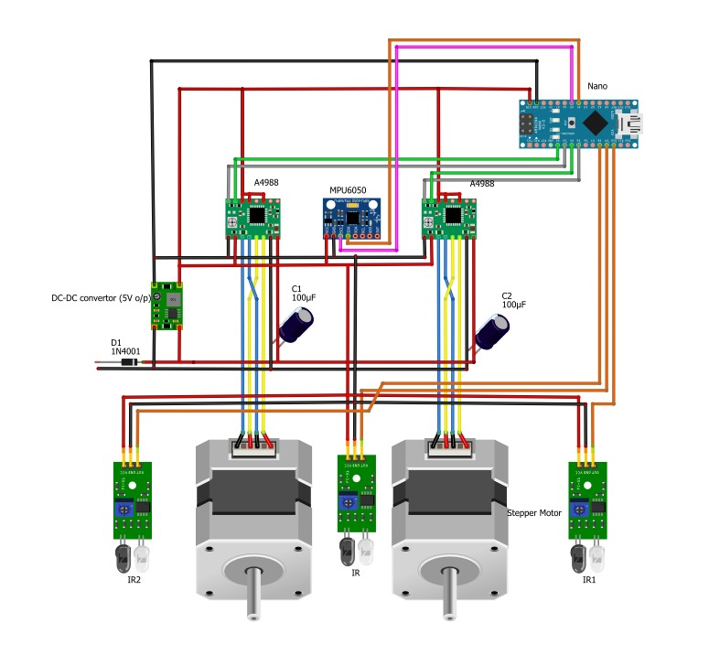
Complete circuit Diagram of our system

Slide 9
Challenges Faced
Tried different values to decide the interrupt time for powering the motors.
Plotted different interrupt values to their to find the best values
Tuning the setpoint values to achieve a speed where the robot maintains a balance.
Multiple iterations to prevent low speeds and overshoot.
And many More…

Slide 10
Thank You!
Team – IIT Bhubaneswar
Two wheel Self balancing robot Mentor – Dr. Satyanarayan Panigrahi Members: 1. Ayush Gupta
2. Divya Kumar
3. Jiya Chakraborty
4. Vivek Singh
5. Rachit Jain

